Slide 1
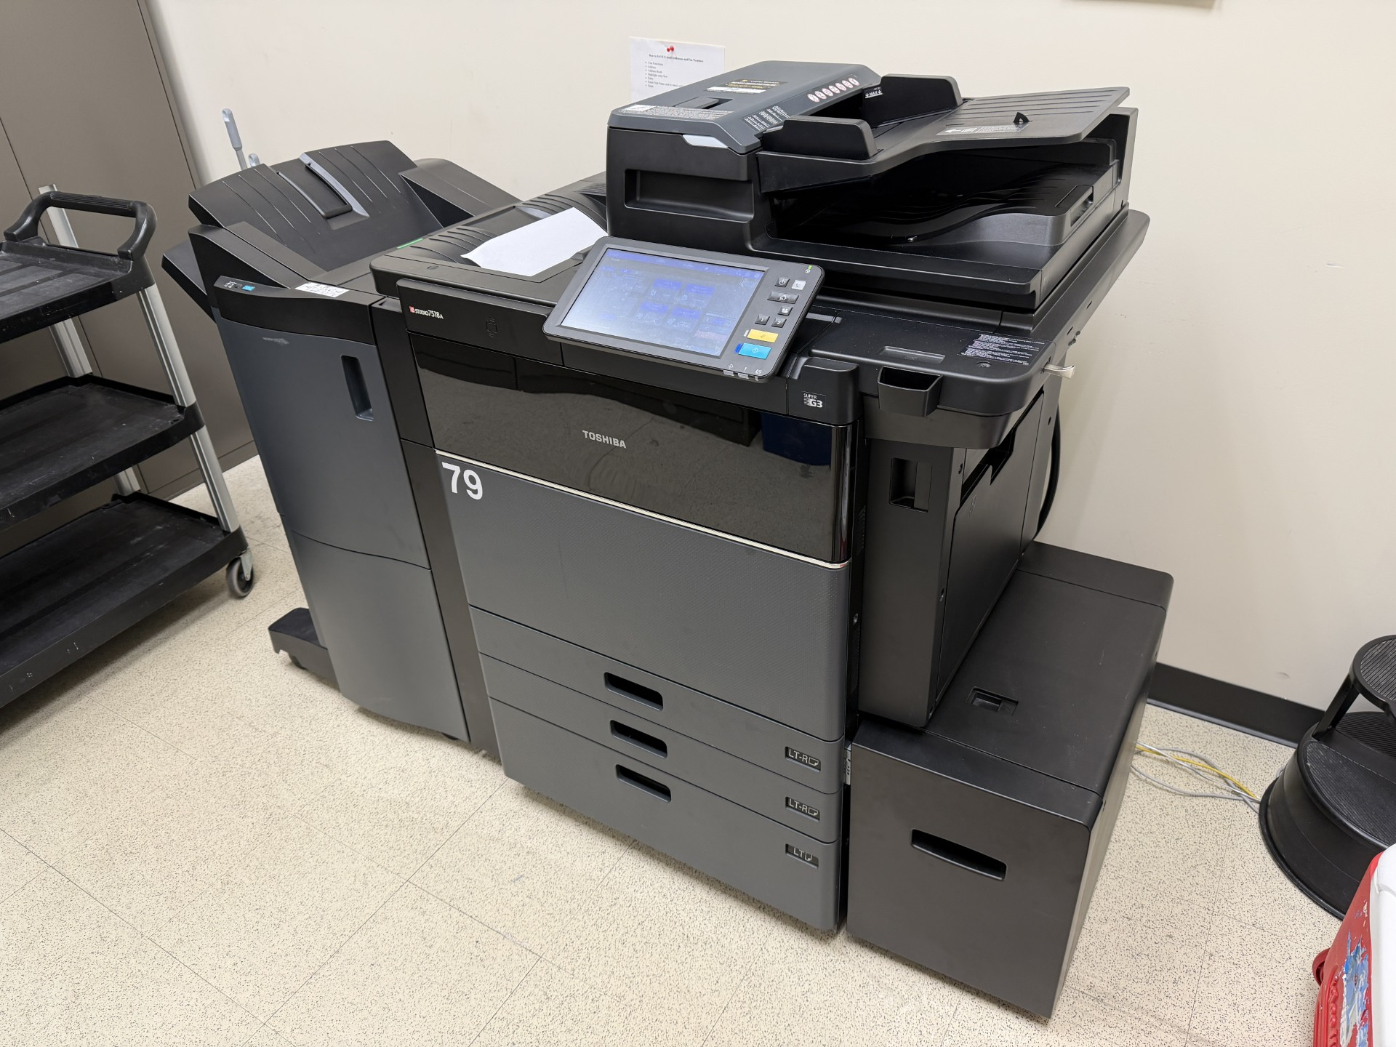
COPY
The "ULTIMATE" Contact Manager
Team #1
Processes for Object Oriented Software Development (COP 4331C) – Spring 2026 – Section 3 with Dr. Aashish Yadavally

Slide 2

What is COPY?
COPY stands for "The Contact Organizer for POOSD with Yadavally." COPY is the website built by Team 1 for the Small Project assignment required by the Processes of Object-Oriented Software Development (aka "POOSD" or COP 4331C) at the University of Central Florida (UCF) in Orlando, FL. It’s a simple implementation of a Contact Manager.
COPY was designed to be an easy way to manage your own personal contact list. COPY supports the following C-R-U-D features:
Adding new contacts (C)
Searching through contacts with partial matching (R)
Editing existing contacts (U)
Deleting existing contacts (D)
The website is at https://copycm.com and you can find the GitHub Repository at https://github.com/ABetinsky/cop4331-sm-project

Slide 3

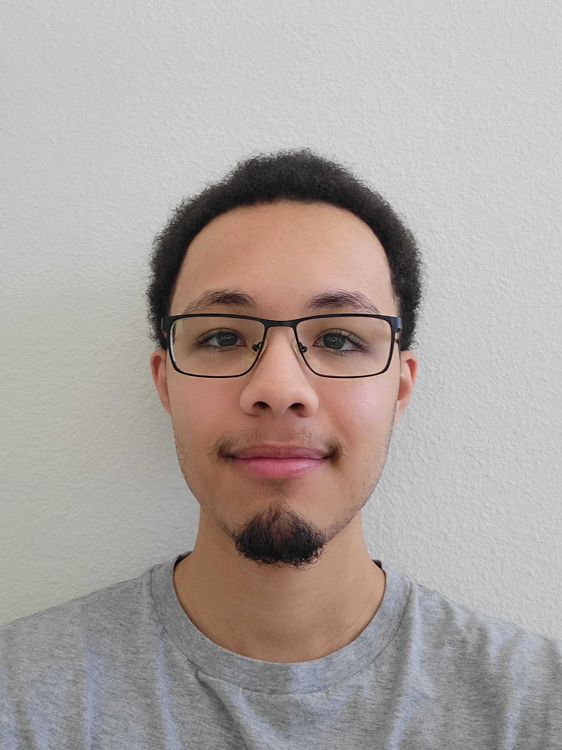
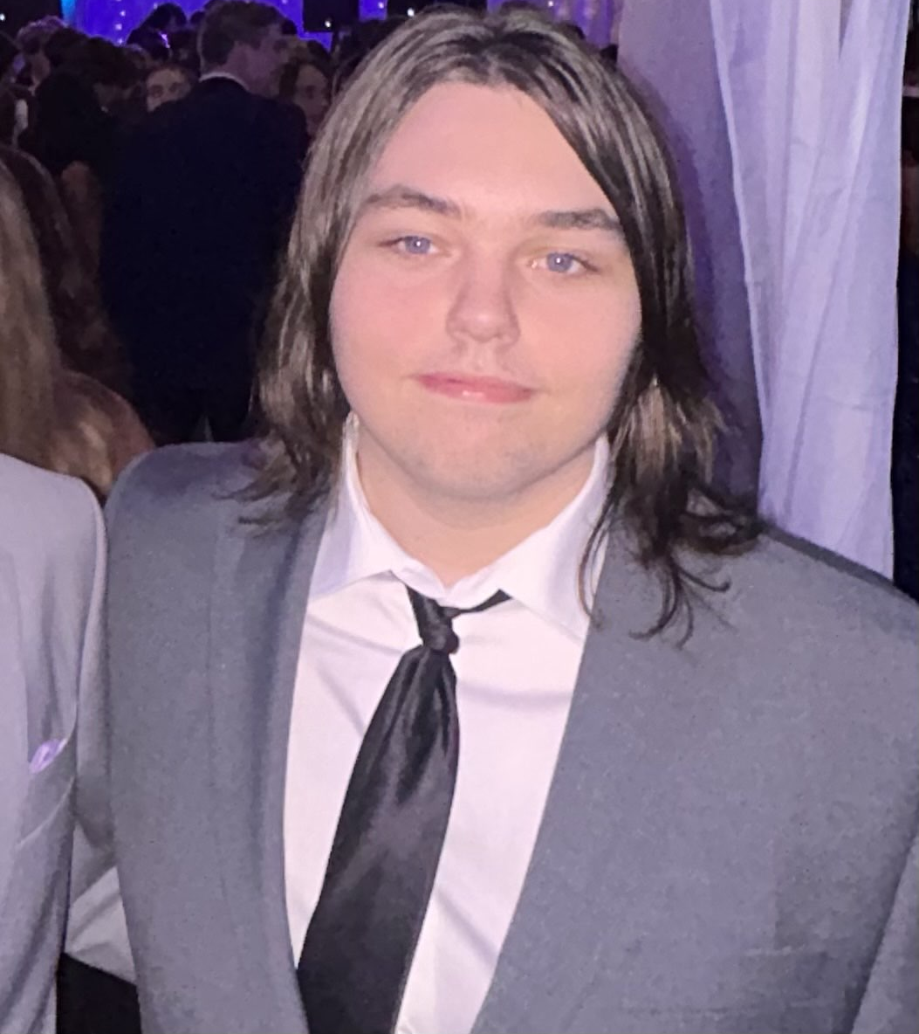

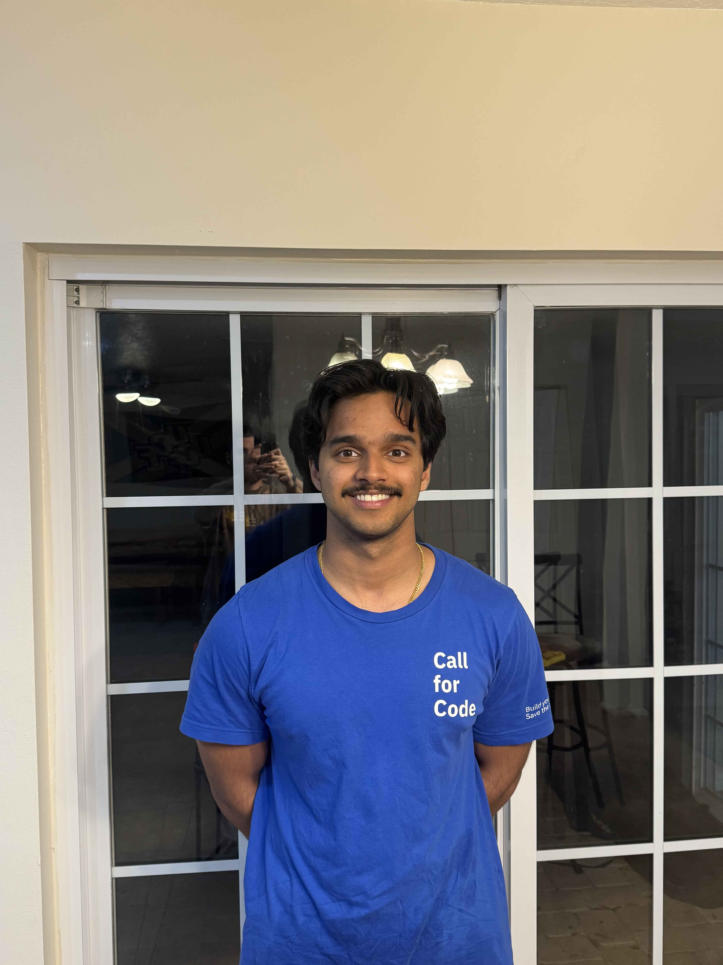

Darren Squires
Database (Backend) and Frontend Developer
Adam Betinsky
Project Manager & Frontend Developer
Andrew Reyes
API Developer
Pranav Cheruku
Database (Backend) and Frontend Developer
Noah Gerard
API Developer
Benjamin Quintero
Frontend Developer

Slide 4
How Did We Make COPY?

Slide 5


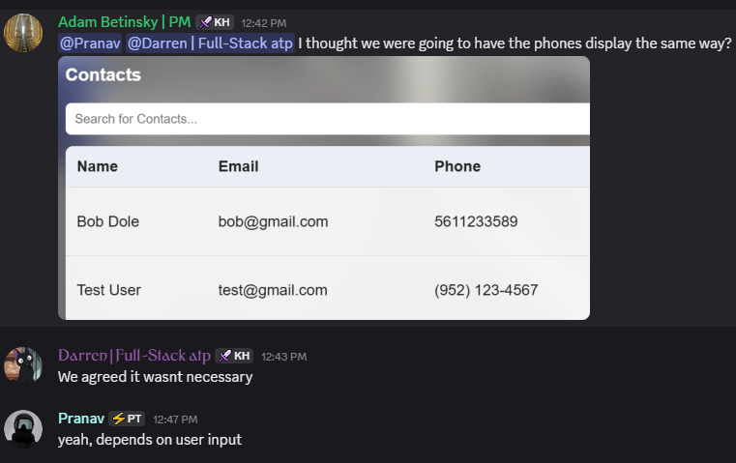
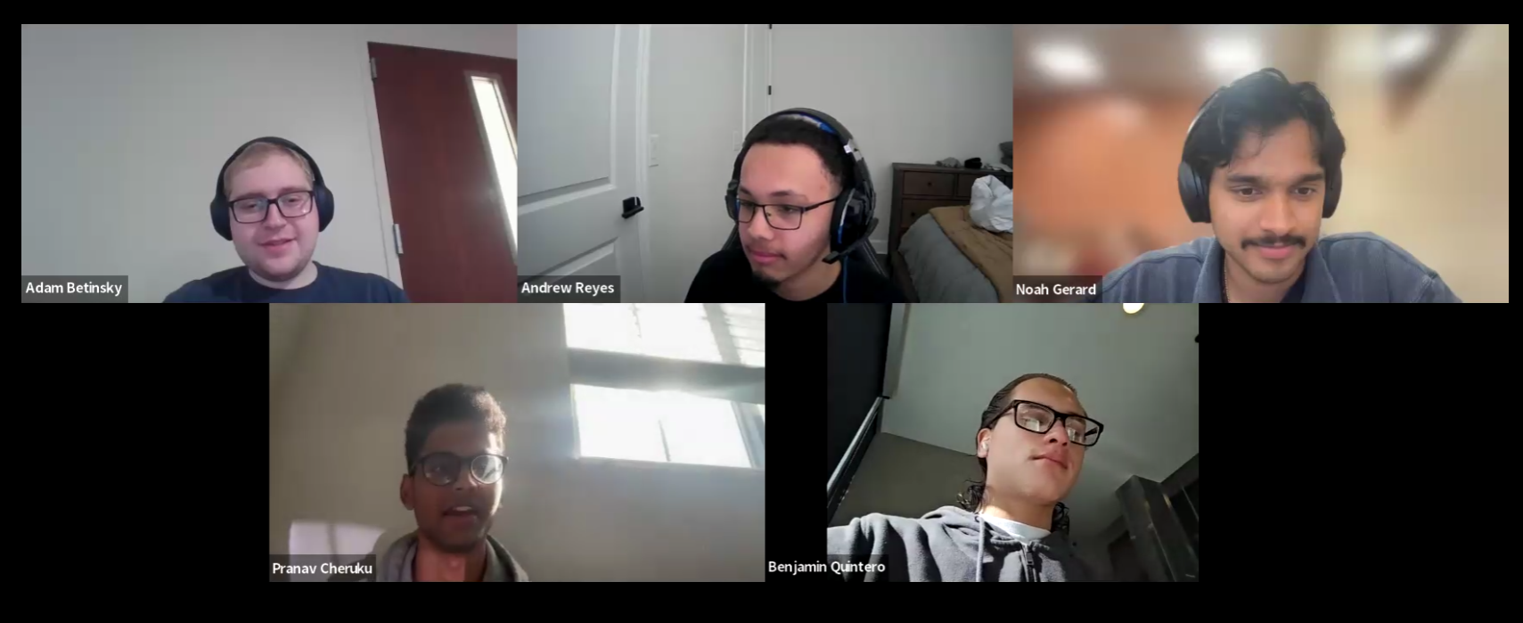
Communication Methods
Primary communication was in a Discord Server
We ensured to check it multiple times daily
We held 4 weekly meetings virtually on Zoom

Slide 6



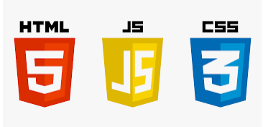
Coding Technologies
Remote Server Hosting: DigitalOcean
Domain Purchasing and DNS Routing: GoDaddy
LAMP Stack:
OS: Linux (Ubuntu 22.04)
Apache 2.4.58
Database: MySQL 8.0.45
PHP 8.4.17
Frontend-Specific:
HTML
JavaScript
CSS

Slide 7


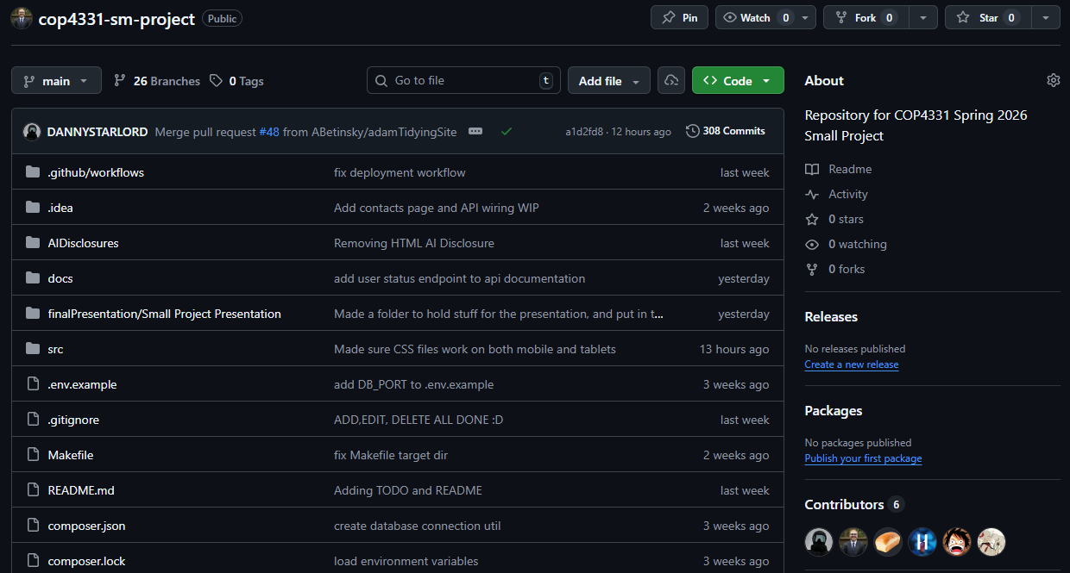
Version Control Git & GitHub
We used a Git repository to easily keep track of any changes to our code
GitHub also provided us real feedback to any conflicts, issues, or other concerns.
Both platforms allowed for us to collaboratively see each other’s changes (especially with new branches) and easily identify if each member was doing their own part
Plus, we setup a listener on our VPS and Discord so that whenever we pushed to our Git repository, it would automatically sync on both platforms as well
The next slide has an example of how we used Pull Requests to ensure a new feature was accurate before fully implementing a change.

Slide 8
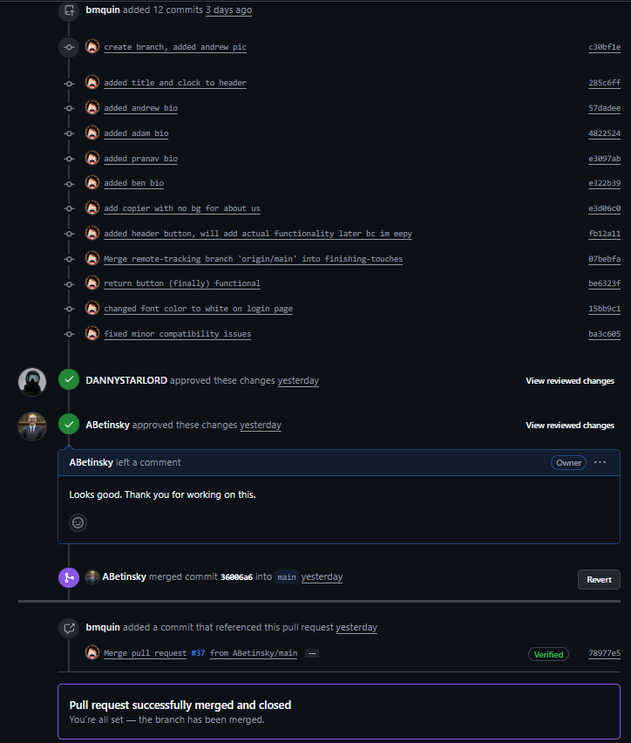
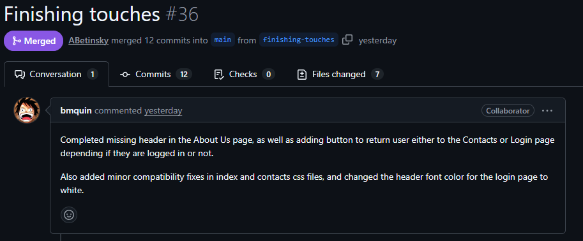
Pull Request Example

Slide 9
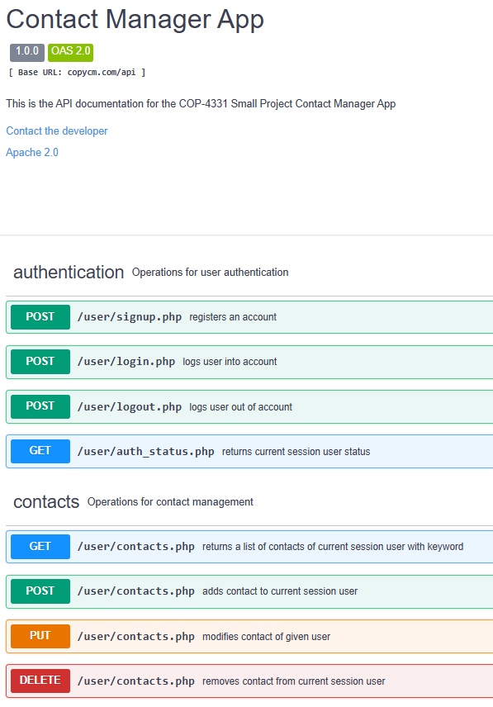
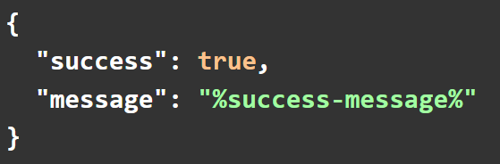
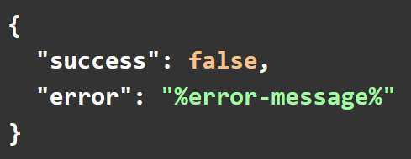
SwaggerHub API Documentation
Success Response:
API Information:
REST-style
Strictly consumes and produces JSON formatted data
All API responses follow the JSON format indicate on the right
Include HTTP Response Code to categorize to response
Handles user and contact operations through SQL queries
Uses cookie-based session handling
Validates and sanitizes request parameters
All SQL queries for API operations occur on the remote server (search occurs on server)
HTTP Response Code:
200 - OK
Error Response:
HTTP Response Codes:
400 – Invalid Input
401 – Invalid Session / Incorrect Credentials
403 – Already Logged In
405 – Method Not Allowed
409 – Credentials Already Taken
500 – Internal Server Error

Slide 10

Artificial Intelligence (AI) Usage
Even though AI is becoming mainstream in software development, we tried to minimize using it
We used ChatGPT for all AI inquires
When we did use it, we primarily used it for teaching
When we did use code generated by AI (which was about 5 times), we were sure to review it thoroughly and fill out an AI Disclosure

Slide 11
Progression Timeline

Slide 12
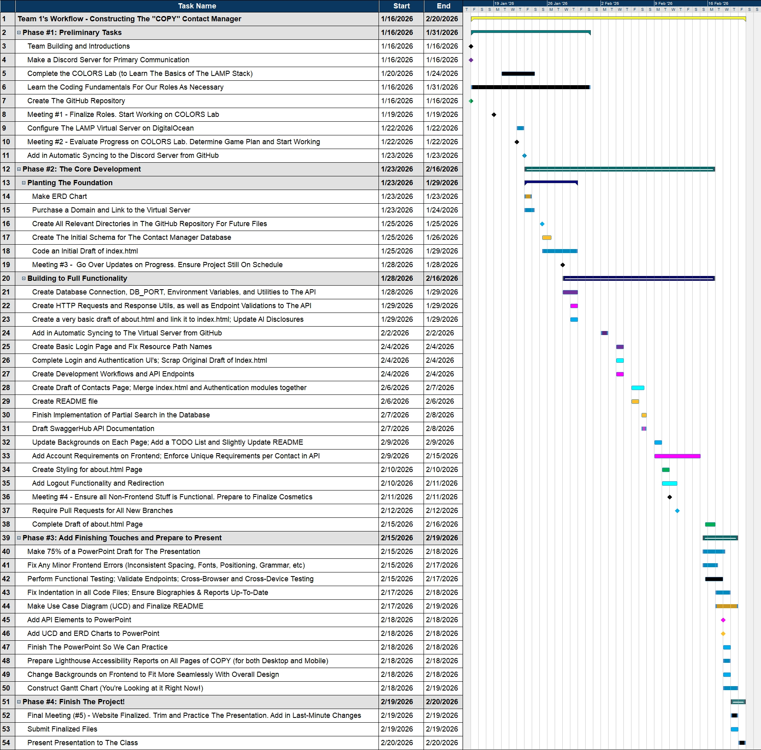

Gantt Chart MindView
We used a software called MindView to create our Gantt Chart.
Although our complete Gantt Chart is on this slide, we will go through each portion (and show the relevant charts) on the next few slides.
Note that in all the following slides: The “Color Key” links colors to team-member in order of appearance

Slide 13
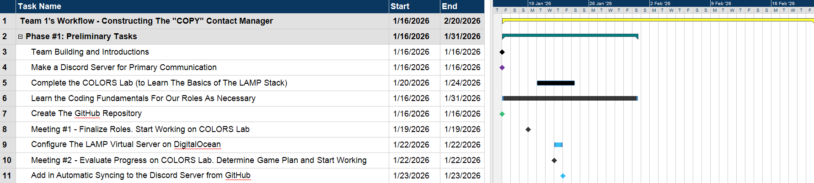
Gantt Chart - Phase #1: Preliminary Tasks
Color Key for Gantt Chart – Phase #1: Preliminary Tasks
Yellow = Overall Project Timeline
Turquoise = A Main Phase Timeline
Black = A Task Completed by Everyone
Purple = A Task Completed by Noah
Green = A Task Completed by Benjamin
Blue = A Task Completed by Adam

Slide 14
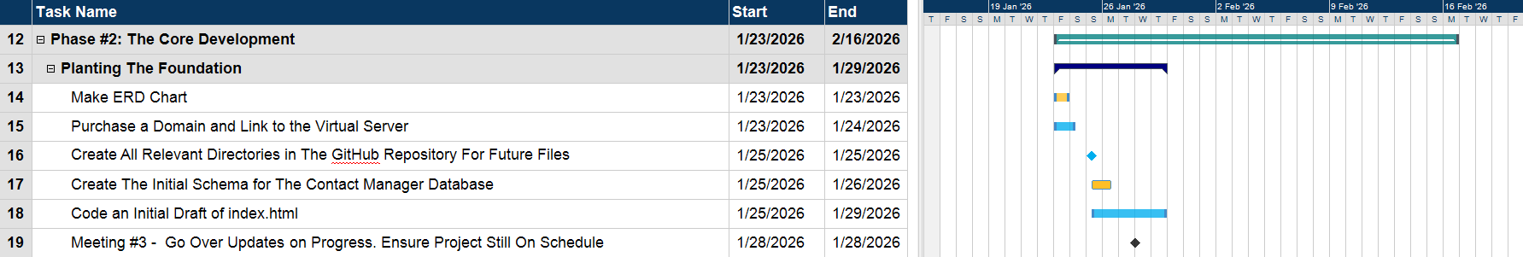
Gantt Chart - Phase #2: The Core Development Part #1: Planting The Foundation
Color Key for Gantt Chart – Phase #2: The Core Development, Part #1: Planting The Foundation
Turquoise = A Main-Phase Timeline
Navy Blue = A Sub-Phase Timeline
Orange = A Task Completed by Darren
Blue = A Task Completed by Adam
Black = A Task Completed by Everyone

Slide 15
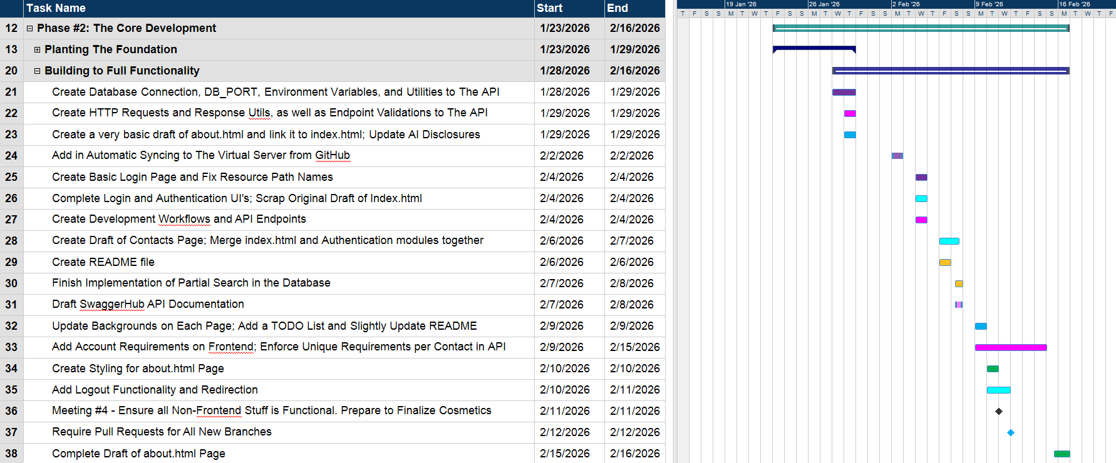
Gantt Chart - Phase #2: The Core Development Part #2: Building to Full Functionality
Color Key for Gantt Chart – Phase #2: The Core Development, Part #2: Building to Full Functionality
Turquoise = A Main-Phase Timeline
Navy Blue = A Sub-Phase Timeline
Purple = A Task Completed by Noah
Pink = A Task Completed by Andrew
Blue = A Task Completed by Adam
Ice Blue = A Task Completed by Pranav
Orange = A Task Completed by Darren
Black = A Task Completed by Everyone
Green = A Task Completed by Benjamin

Slide 16
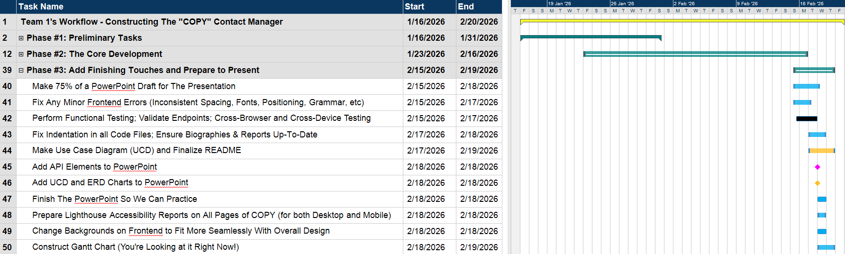
Gantt Chart - Phase #3: Add Finishing Touches to Prepare and Present
Color Key for Gantt Chart – Phase #3: Add Finishing Touches to Prepare and Present
Yellow = Overall Project Timeline
Turquoise = A Main Phase Timeline
Blue = A Task Completed by Adam
Black = A Task Completed by Everyone
Orange = A Task Completed by Darren
Pink = A Task Completed by Andrew

Slide 17
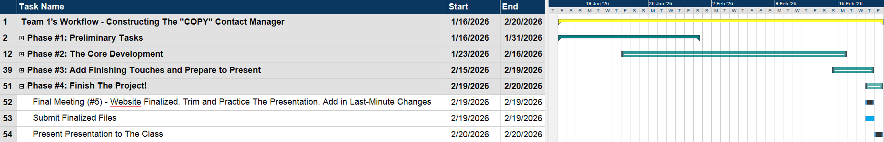
Gantt Chart - Phase #4: Finish The Project!
Color Key for Gantt Chart – Phase #4: Finish the Project!
Yellow = Overall Project Timeline
Turquoise = A Main Phase Timeline
Black = A Task Completed by Everyone
Blue = A Task Completed by Adam

Slide 18
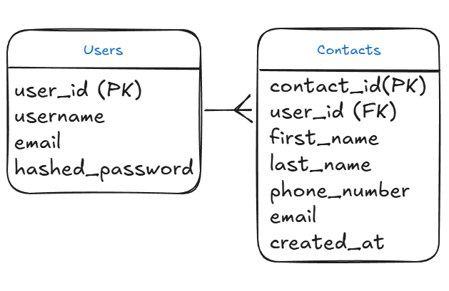
ERD Chart
The database is structured around two core entities: Users and Contacts.
A one-to-many relationship is used because one user can have many contacts, but each contact belongs to exactly one user.
The user_id in the Contacts table is a foreign key that enforces data ownership and prevents cross-user access.
Separate tables were used to maintain data isolation, security, and normalization.
Passwords are stored as hashed_password to follow basic security best practices.
The structure supports all CRUD operations efficiently while keeping the schema simple and scalable.

Slide 19
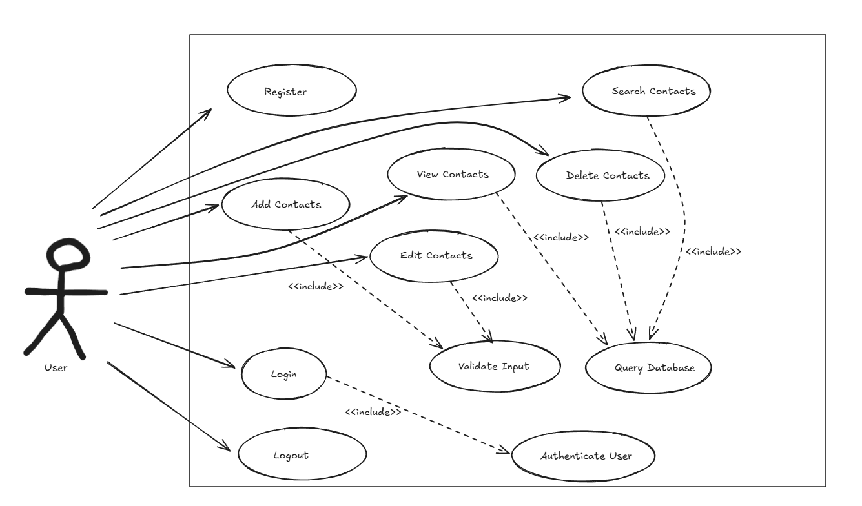
Use Case Diagram
The diagram centers around a single user actor
All contact operations map directly to CRUD functionality
<<include>> was used for shared processes like validation, authentication, and database queries
This design improves modularity and reflects how the backend logic is structured

Slide 20
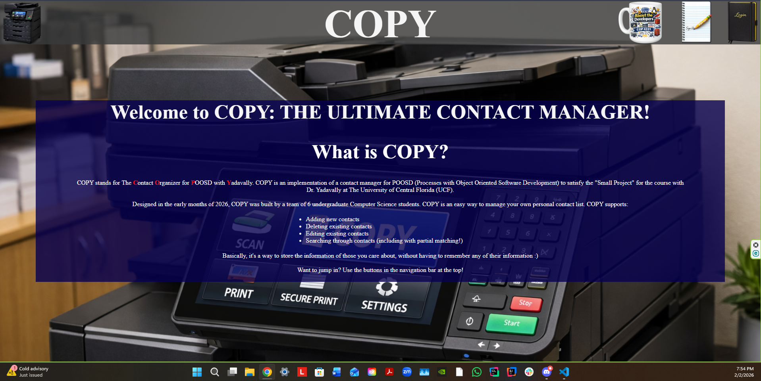
Overall Things That Did Go Well
We got to work right away at the beginning of week 2
We made sure to reach out to each other if we had different ideas, issues, or general concerns
We ensured that we made decent progress to keep the project on schedule
Assisting each other as much as possible when we we’re stuck
Our first (and very bad) draft of index.html

Slide 21
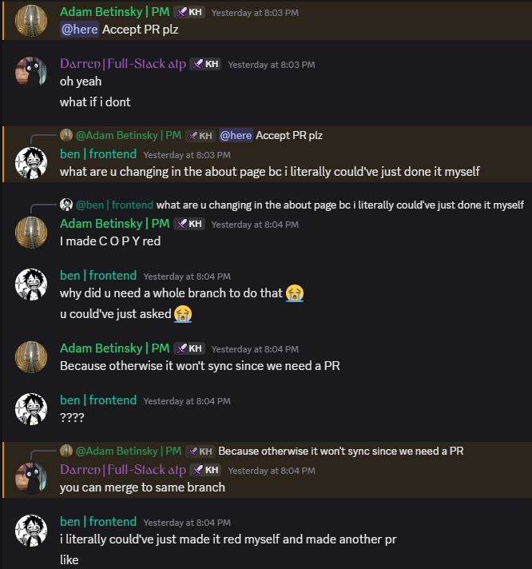
Overall Things That Did NOT Go Well
We had conflicts from time-to-time
Whether it be about different ideas for the website design, how to organize the Git repository, or arguing over who should do a task, it was inevitable
We had a few occasions where some group members slacked a little and didn’t do their part
We had some miscommunication and confusion at times with the project requirements and/or implementation

Slide 22
Website and API Demonstrations

Slide 23
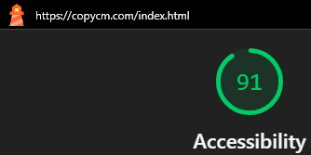
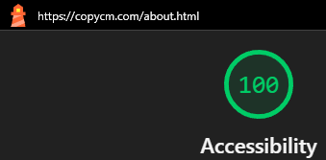
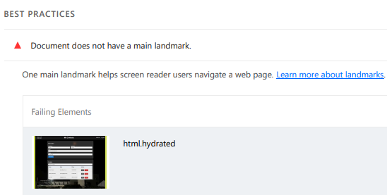
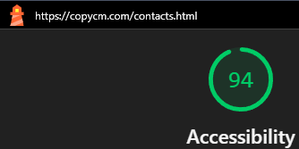
Accessibility: Lighthouse Scores
90+ (“Excellent”) Lighthouse scores on all 3 pages
Only possible issues are for users that use screen readers
For example, we could improve the contacts page with a single main landmark

Slide 24
Any Questions?

Slide 25
Outside Images Used in This Presentation
Main Background: https://www.pexels.com/photo/lines-of-code-2653362/
Discord Logo: https://www.vecteezy.com/vector-art/6892625-discord-logo-icon-editorial-vector
Zoom Logo: https://1000logos.net/zoom-logo/
LAMP Stack: https://www.geekboots.com/story/lamp-stack-and-its-advantages
Git Logo: https://www.google.com/imgres?q=git%20logo&imgurl=https%3A%2F%2Fgit-scm.com%2Fimages%2Flogos%2Fdownloads%2FGit-Icon-1788C.png&imgrefurl=https%3A%2F%2Fgit-scm.com%2Fcommunity%2Flogos&docid=CMTH9vchny6mPM&tbnid=jpq4xLgv36ZQ1M&vet=12ahUKEwjlx6X8muKSAxWKmmoFHdFvE2QQnPAOegQIIBAB..i&w=383&h=383&hcb=2&ved=2ahUKEwjlx6X8muKSAxWKmmoFHdFvE2QQnPAOegQIIBAB
GitHub Logo: https://pixabay.com/vectors/github-github-logo-github-icon-6980894/
ChatGPT Logo: https://logovent.com/blog/chatgpt-logo-history/
MindView Logo: https://ul.gpii.net/content/mindview-7
DigitialOcean Logo: https://en.wikipedia.org/wiki/DigitalOcean
GoDaddy Logo: https://www.logo.wine/logo/GoDaddy
HTML/JavaScript/CSS Logos: https://www.sitepoint.com/community/t/what-is-the-official-javascript-logo/365775

Slide 26
Thank You!

